Slide 1
JOIN WIFI:
VirusGenerator
VGAquarius090317

Slide 2
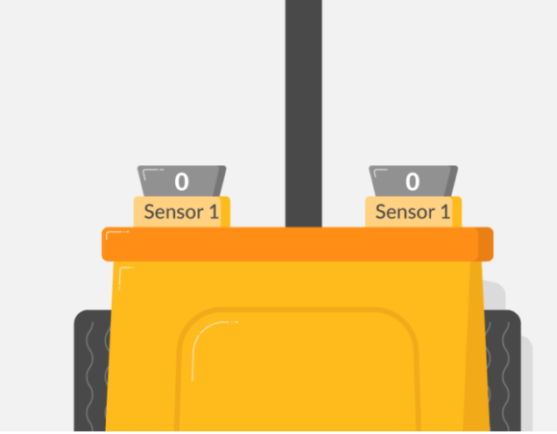
TO CREATE A LINE FOLLOWING ROBOT

Slide 3
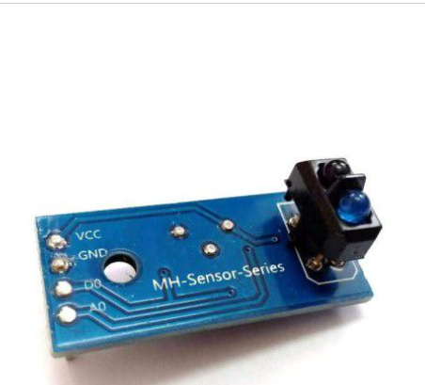
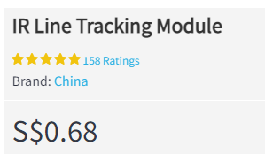
IR (Infra-Red) LINE SENSORS
The line sensor has the following pins to connect to the Raspberry Pi:
VCC needs to be connected to a voltage in between 3.3 and 5V, to power the device
GND is the ground pin that is required to complete the circuit
AO is the analogue output (this will not work with the Raspberry Pi)
DO is the digital output pin (this will work with the Raspberry Pi)

Slide 4
Line sensors detect the presence of a black line by emitting
infrared (IR) light and detecting the light levels
that return to the sensor.
They do this using two components:
an emitter and a light sensor (receiver).
SENSORS
BLACK LINE DETECTED = 1 (LED OFF)
NOT DETECTED = 0 (LED ON)

Slide 5
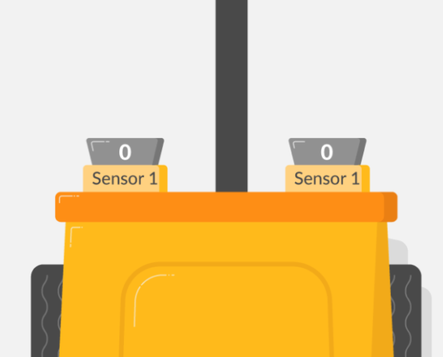
If the line is in the centre of the robot,
both sensors will return a 0 from their digital pins,
as they are both over the white background.

Slide 6
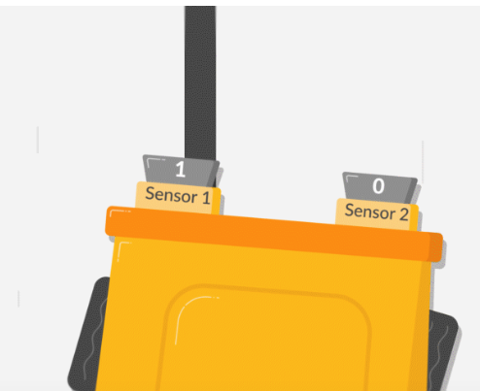
If the sensor hits a black line,
meaning it as veered - to the right in this case,
the IR Sensor will have an output of 1. (LED goes OFF)
The program in reaction to this will have to
move the robot away from the black line – TURN LEFT

Slide 7
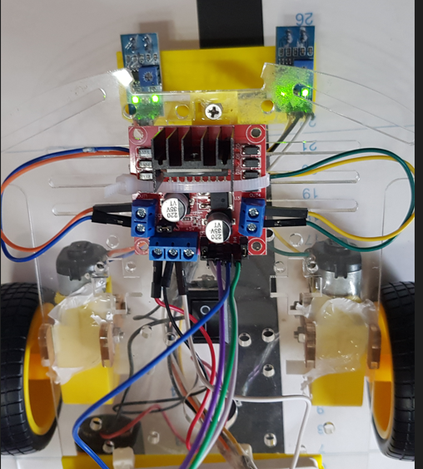
Mounting the IR
Sensors on to the
Robot
Sensor Holder

Slide 8
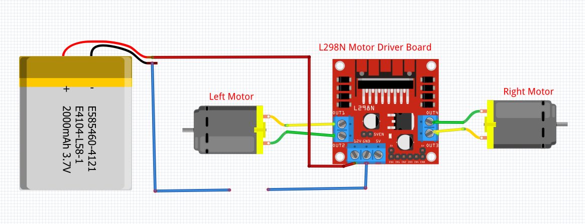
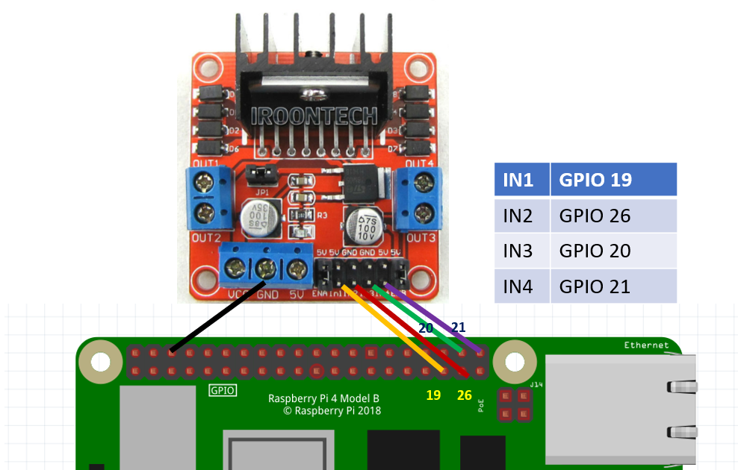
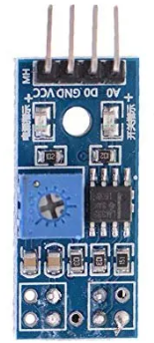
LINE FOLLOWER ROBOT
WIRING DIAGRAM
17
5V
GND
27
RIGHT SENSOR
LEFT SENSOR

